Slide 1
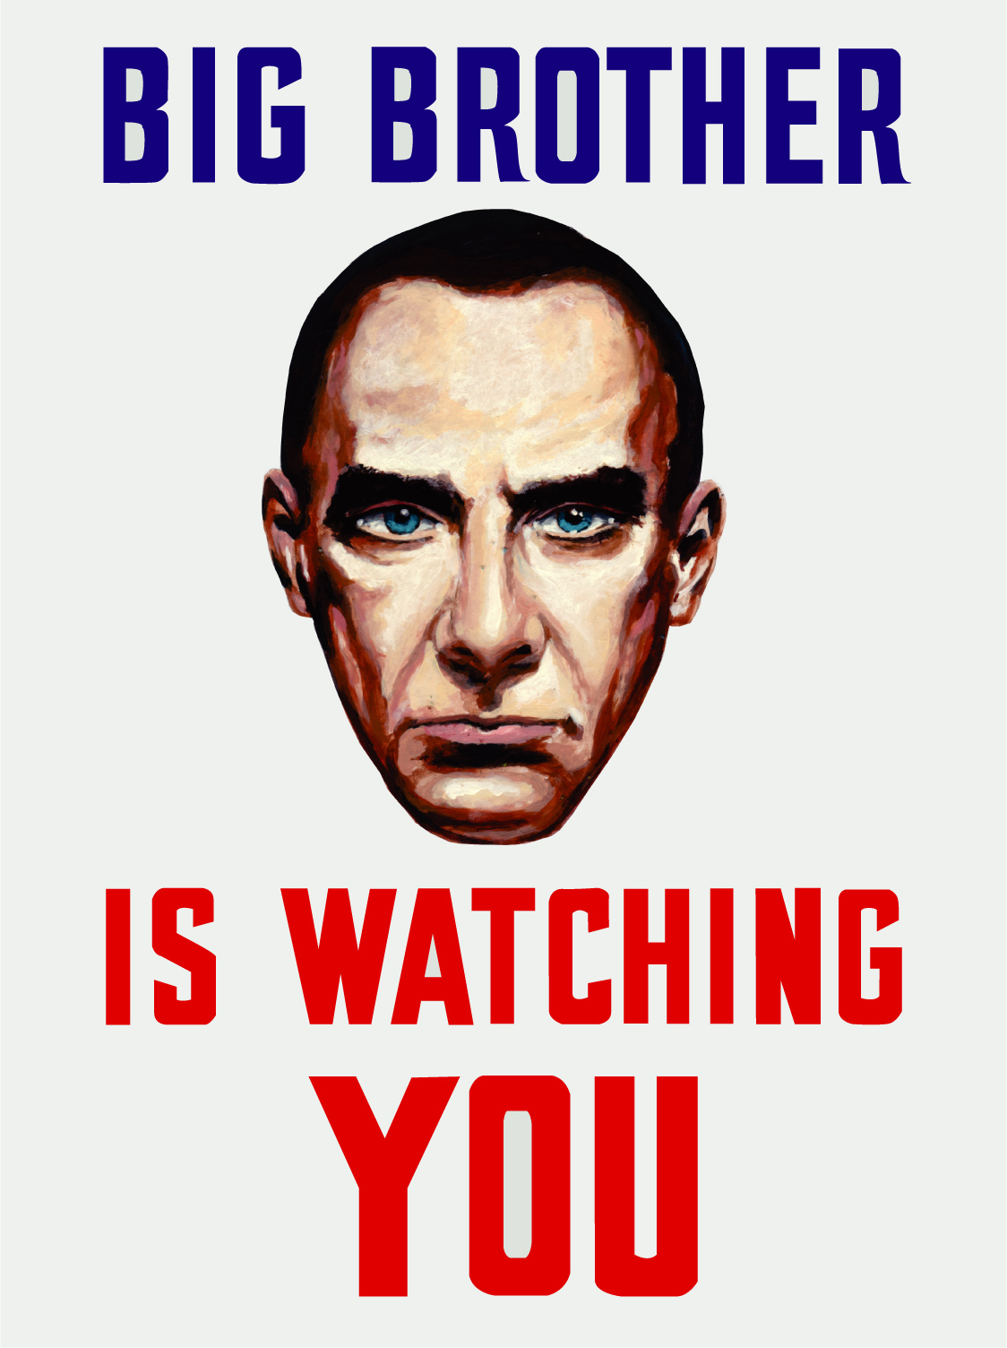
Is there too much surveillance in modern society?
How does this fit in with ideas of a dystopian society?

Slide 2
L.O.
Compare and contrast dystopian fiction
S.C.
Identify similarities and differences
Consider how context affects meaning
Discuss how earlier texts influence modern ones

Slide 3

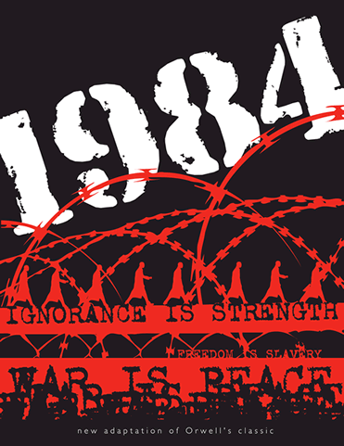
Read the opening extract from 1984.
Can you highlight any examples of dystopian conventions?
Extension Task – In a different colour, highlight anything which suggests that the viewpoint character is a typical dystopian protagonist (main character).

Slide 4
The Hunger Games
1984
Similarities

Slide 5
The rise to power of dictators such as Adolf Hitler in Germany and Joseph Stalin in the Soviet Union inspired Orwell’s mounting hatred of totalitarianism and political authority. Orwell devoted his energy to writing novels that were politically charged, first with Animal Farm in 1945, then with 1984 in 1949.
1984 is one of the most powerful warnings ever issued against the dangers of a totalitarian society. In Germany, and the Soviet Union, Orwell had witnessed the danger of absolute political authority in an age of advanced technology. 1984 shows the worst human society imaginable, in an effort to convince readers to avoid any path that might lead toward such societal degradation. In 1949, at the dawn of the nuclear age and before the television had become a fixture in the family home, Orwell’s vision of a post-atomic dictatorship in which every individual would be monitored ceaselessly by means of the telescreen seemed terrifyingly possible.
Using the information above to help you, discuss how people in 1949 might have reacted to the novel 1984.

Slide 6
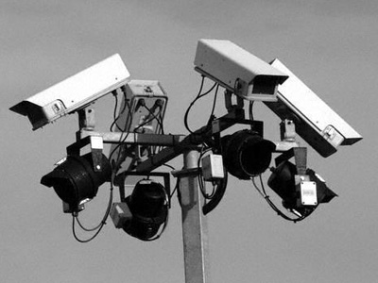
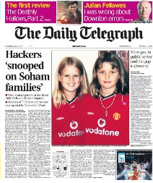

Does 1984 take on a different meaning/significance in modern society? Is it still relevant?

Slide 7
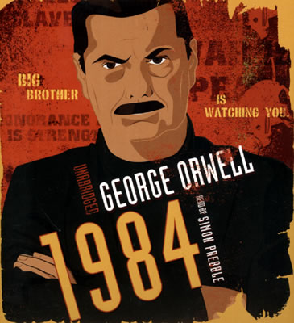
In what ways has 1984 influenced our society?
In what ways has it influenced later novels such as The Hunger Games?
Use the information you have gained from today’s lesson to help inform your answer.
Extension Task – Do you think 1984 has helped or hindered society in any way? What message do you think we should take from its themes?

